Slide 1
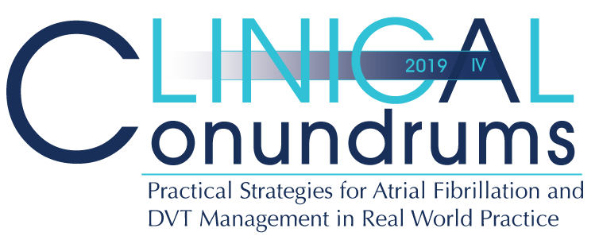



Case 3
CASE 5
Miguel
Management of Atrial Fibrillation in Post Stroke Patients

Slide 2

Learning Objectives
Upon completion of this activity, participants should be able to:
I
Discuss the importance of diagnosing subclinical AF in stroke patients and of anticoagulation strategies to prevent recurring stroke
II
Identify clinical factors from trials and guidelines that may influence the choice of oral anticoagulant in secondary stroke prevention

Slide 3

Case 3
Miguel was seen in ER 10 days ago with some slurred speech and right arm weakness (lasted 1 hr)
He was then seen at regional Stroke Centre within 24 hrs
Miguel
79 years old
Test Results:
Brain CT: Small-sized infarct of the left frontal lobe, no bleed
CT Angio of cervicocephalic arteries: Left ICA <50% stenosis
Echocardiogram: Mild aortic valve stenosis
24-hour Holter: No atrial fibrillation
Notes:
Speaker Notes:
The likelihood of an atherosclerotic plaque being the cause of an ischemic stroke increases with the degree of stenosis. Fred’s internal carotid artery (ICA) stenosis of <50% is probably not the cause of his nonlacunar stroke. Despite of a 24-hour Holter showing no atrial fibrillation, the treating physician should investigate further for subclinical atrial fibrillation (SCAF). If > 50% ICA stenosis were found and 24h Holter is negative for AF, short term (3 week) combined antiplatelet therapy with ASA 80 mg + clopidogrel 75 mg OD followed by long-term antiplatelet monotherapy with either ASA 80 mg OD or clopidogrel 75 mg OD would be appropriate treatment, together with possible ICA revascularization following guidelines. In all cases, modifiable risk factors of atherosclerosis should be controlled.
Aortic valve sclerosis or fibrocalcification with any degree of aortic stenosis does not confer clinically significant risk for embolic stroke. AF in this setting is considered « nonvalvular » and a DOAC is appropriate if the patient qualifies for long-term anticoagulation based on the CCS CHADS-65 algorithm.

Slide 4
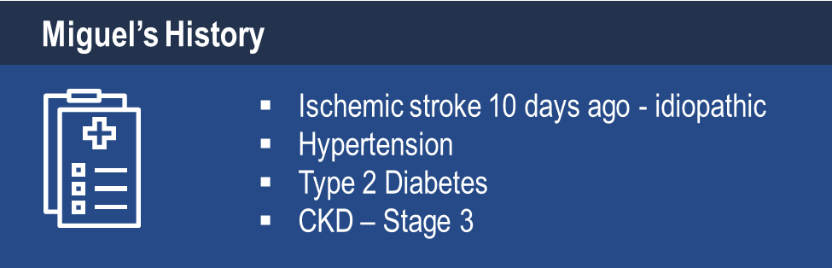
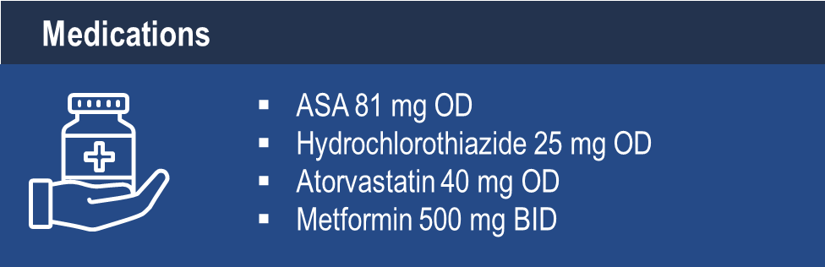
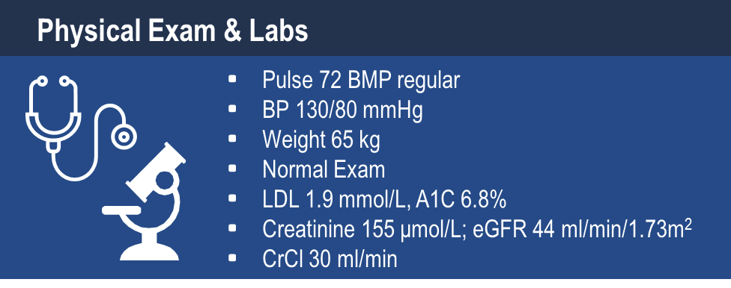
Case 3
Miguel
79 years old
Notes:
Speaker Notes:
BP seems well controlled in the office setting but Fred may have “masked HTN” as he is on a low dose diuretic monotherapy. Consider a switch to a long acting thiazide-like diuretic such as indapamide 2.5 mg OD per Hypertension Canada Guidelinessince 2017.
- Creatinine 155 μmol/L = eGFR 44 ml/min/1.73m² = CrCl 30 ml/min : shows importance of calculating the CrCl in this setting. Fred is still eligible for a DOAC but will require close monitoring of his renal function and preferably an agent with low renal clearance such as apixaban (27%) or rivaroxaban (36%). Both choices would require dosage adjustment as he meets two of three “ABC” criteria for apixaban (age > 80 and creatinie > 133) and the CrCl <50 ml/min criterion for rivaroxaban.

Slide 5

Case 3
10 days after discharge, Miguel comes to your office for a follow-up
Notes:
Speaker Notes:

Slide 6

What is your management step?
Select from one or more of the available options
Treat for two weeks with DAPT (clopidogrel + ASA), then with ASA alone thereafter
Refer him to a stroke clinic (8 week wait…)
Order prolonged (e.g. 2-4 week) external monitoring
Discontinue HCTZ and replace with perindopril 4 mg OD
DAPT = double antiplatelet therapy
Notes:
Speaker Notes:
Answers 1. 3. 4. are all correct
Key Points:
For a minor ischemic stroke without evidence of AF, recommended treatment is a three week period of DAPT (e.g. clopidogrel 300 mg bolus followed by 75 mg OD + ASA 75 mg OD) and then single long-term antiplatelet therapy with ASA 80 mg OD.
Perindopril 4 mg +/- indapamide significantly reduced fatal / nonfatal stroke recurrence post stroke / TIA in the PROGRESS trial (Lancet 2001;358:1033-1041).
In patients in whom AF is suspected based on symptoms or history of CVA or TIA, a longer term (e.g. 2-4 week) ECG monitoring with event loop recorder (e.g. King of Hearts, CardioStat) is recommended as these can significantly increase subclinical AF detection rate.

Slide 7
What percent of strokes are idiopathic (or “cryptogenic”)?
Select from one of the available options
<10%
10-20%
20-30%
30-40%
I am not sure
Notes:
Speaker Notes:
The percentage of idiopathic or cryptogenic strokes (20-30%) will vary with the intensity with which underlying subclinical AF is sought… SCAF is detected in just 2-4% cases with 24hr Holter monitoring but in up to to 14% of cases with repeated Holters or 2-4 wk external loop recorders… The harder you look, the more SCAF you find!

Slide 8
Stroke Types and Incidence
Hemorrhagic Stroke 15%
Other 5%
Cryptogenic 30%
Atherosclerotic
Cerebrovascular
Disease
20%
Cardiogenic Embolism 20%
Small Vessel
Disease
“lacunes”
25%
Ischemic Stroke 85%
Albers GW, et al. Chest 2004; 126 (3 Suppl): 438S–512S
McGrath et al. Stroke 2012; 43: 2048-2054.
Notes:
Speaker Notes:
Cryptogenic stroke-A stroke which cannot be attributed to any specific cause after an extensive search for the most common causes Cardiogenic embolism-stroke as a result of an embolic cardiac source (AF) Small vessel lacunar stroke- stroke from occlusion of deep penetrating brain arteries

Slide 9
What percent of cryptogenic strokes are due to AF?
Select from one of the available options
10%
15%
30%
45%
We don’t know
Notes:
Speaker Notes:
Correct Answer: 5
The percentage varies from 9% after 6 months of monitoring (Sanna et al. Cristal AF. NEJM 2014;370:2478) and 15% at 1-month monitoring (Gladstone et al.) to 43% after 30.5 months of follow-up (Ntaios G et al. Stroke 2015;46:176).

Slide 10
Idiopathic Stroke and AF
Paroxysmal atrial fibrillation is often asymptomatic or subclinical (SCAF) and goes undetected, especially during short intervals of observation. As a result, SCAF can go untreated in the routine care of patients with ischemic stroke or transient ischemic attack (TIA).
SCAF = Subclinical atrial fibrillation
Gladstone DJ, Spring M, Dorian P, Panzov V, Thorpe KE, Hall J, et al.
N Engl J Med 2014; 370:2467-2477.
Notes:
Speaker Notes:
See next slide

Slide 11
AF Detection Increases with Duration of Investigation in Idiopathic Stroke
Detection of paroxysmal AF increased from 2% / 24 hours to 15% over 4 weeks
Patients with Atrial Fibrillation
Detected (%)
Duration of ECG Monitoring
Incremental Yield of Prolonged ECG Monitoring for the Detection of Atrial Fibrillation in Patients with Cryptogenic Stroke or TIA.
Gladstone DJ et al. N Engl J Med 2014;370;2467-2477
Notes:
Speaker Notes:
Among patients with a recent cryptogenic stroke or TIA who were 55 years of age or older, paroxysmal atrial f ibrillation was common. Noninvasive ambulatory ECG monitoring for a target of 30 days signif icantly improved the detection of atrial f ibrillation by a factor of more than f ive and nearly doubled the rate of anticoagulant treatment, as compared with the standard practice of short-duration ECG monitoring. (Funded by the Canadian Stroke Network and others; EMBRACE ClinicalTrials.gov number, NCT00846924.)
Figure 2. Incremental Yield of Prolonged ECG Monitoring for the Detection of Atrial Fibrillation in Patients with Cryptogenic Stroke or TIA.
The proportion of patients in whom atrial fibrillation was detected increased with increasing duration of ECG monitoring. The data ref lect the timing of the first detected episode of atrial fibrillation; data for 2 patients are not shown because the exact date of the detection of atrial fibrillation was un- known. Atrial fibrillation was detected in 6 of 277 patients who underwent monitoring with a 24-hour Holter monitor (the control group). In the group of 284 patients who underwent 30-day monitoring, atrial fibrillation was detected in 21 patients within the first week of monitoring, in 33 within the first 2 weeks of monitoring, in 35 within the first 3 weeks of monitoring, and in 42 within 4 weeks of monitoring (including 1 patient with atrial fibrillation that was first detected on day 34).

Slide 12

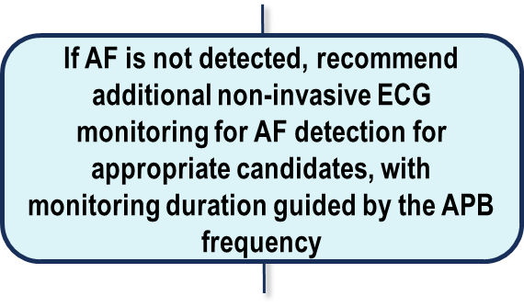
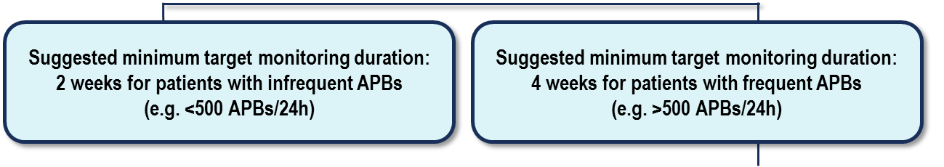
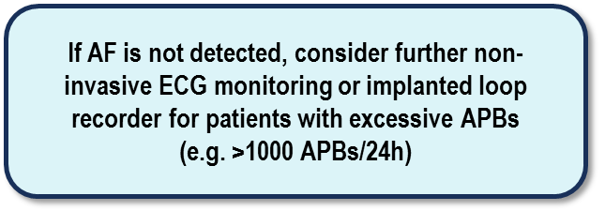
Suggested Algorithm in Ischemic Stroke or TIA Patients with Suspected Paroxysmal AF
APB = atrial premature beat.
Gladstone et al. Stroke. 2015;46:936-941
Notes:
Speaker Notes:
A suggested algorithm for detecting subclinical atrial fibrillation (AF) in patients being investigated after an embolic ischemic stroke or transient ischemic attack. APB indicates atrial premature beat.

Slide 13
Case 3
Miguel has paroxysmal AF
Notes:
Speaker Notes:

Slide 14
What is Miguel’s risk of another stroke?
Select from one of the available options
2% /year
6% /year
12% /year
Notes:
Speaker Notes:
Correct answer is 3. 12%

Slide 15
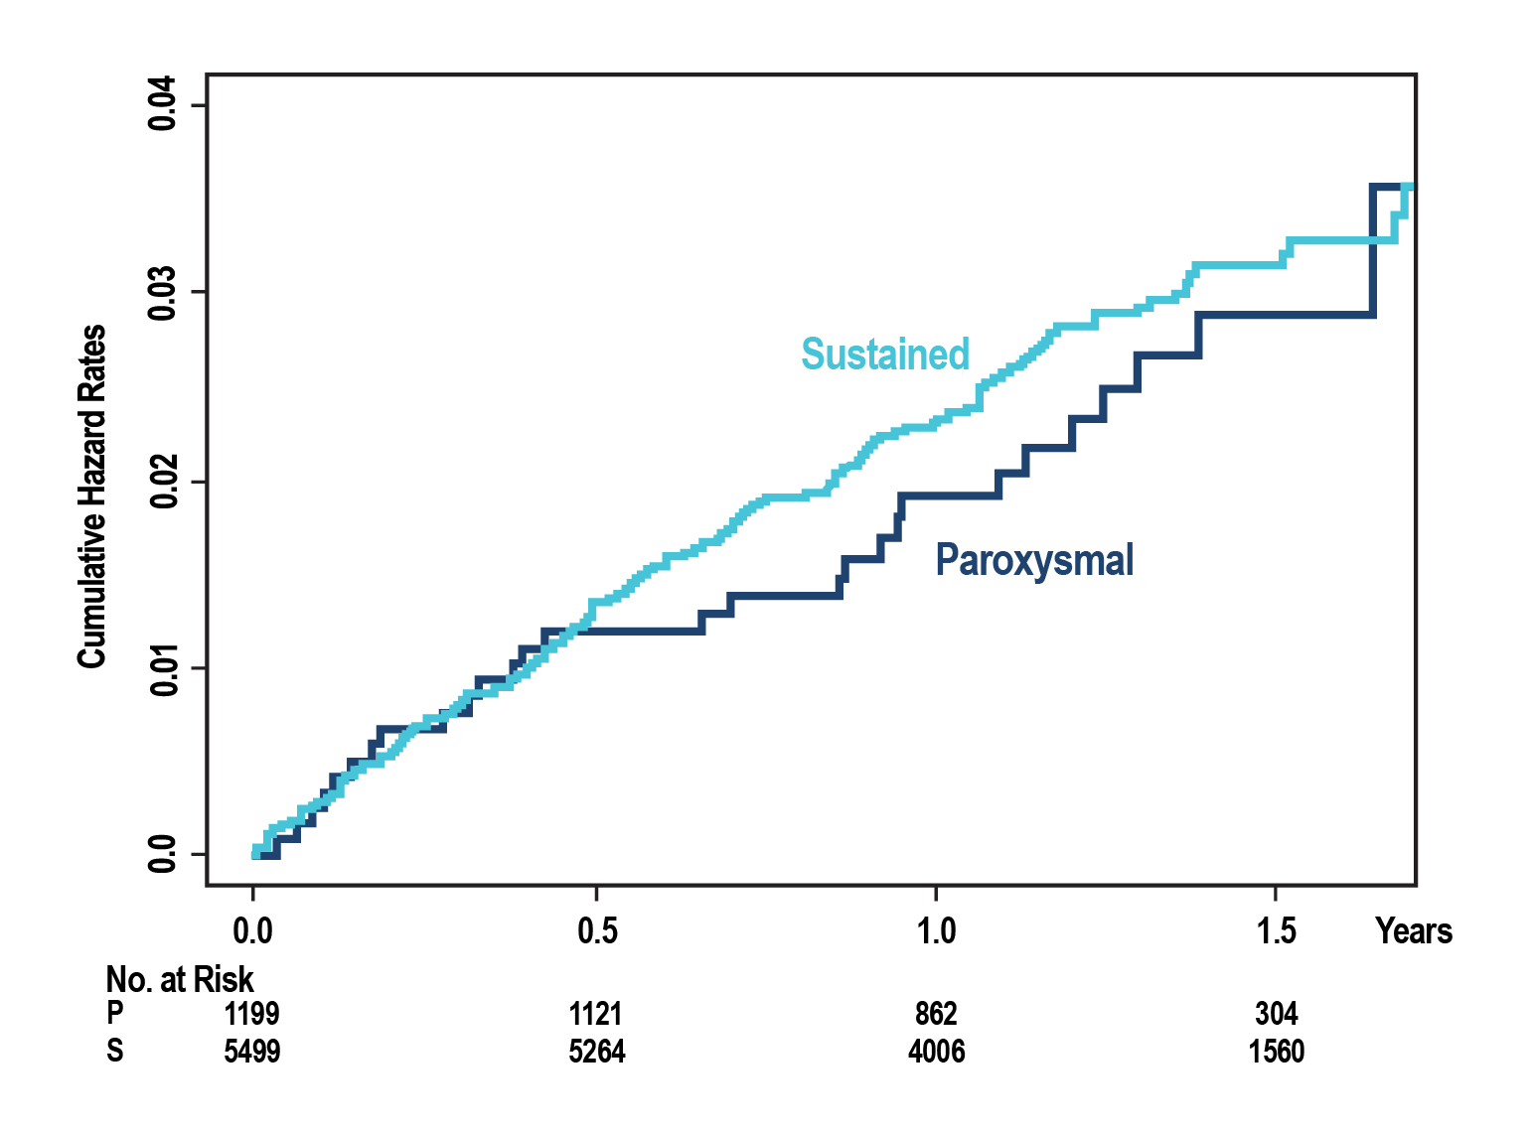
Incidence of Stroke in Paroxysmal is as High as Sustained AF in Patients Taking OAC or Combined Antiplatelet Therapy
The RR of paroxysmal AF compared to sustained AF was 0.94 (95% CI 0.63 to 1.40, p =0.755)
Stroke risk same, irrespective of AF type
N=6706
AF patients
Gladstone DJ et al. N Engl J Med 2014;370;2467-2477
Notes:
Speaker Notes:
The annualized risk of stroke or non-central nervous system (CNS) systemic embolism was 2.0 in paroxysmal AF compared with 2.2 in sustained AF (relative risk 0.87, 95% confidence interval [CI] 0.59 to 1.30, p = 0.496). After adjusting for confounding baseline variables, the relative risk was 0.94 (95% CI 0.63 to 1.40, p = 0.755)

Slide 16

Calculate Miguel’s Stroke Risk
Miguel’s Stroke Risk = 12.5% / yr
1733 patients from National Registry of Atrial Fibrillation (NRAF)
Stroke rate/ 100 patient-years
Risk Factor | Score | Miguel
Congestive Heart Failure | 1 | 0
Hypertension (history of) | 1 | 1
Age ≥ 75 | 1 | 1
Diabetes Mellitus | 1 | 1
Stroke in the past | 2 | 2
Maximum Score | 6 | 5
CHADS₂
Gage BF et al. JAMA 2001;285:2864-70
Notes:
Speaker Notes:
Highlight “2 point” impact of previous stroke or TIA on the CHADS2 score

Slide 17
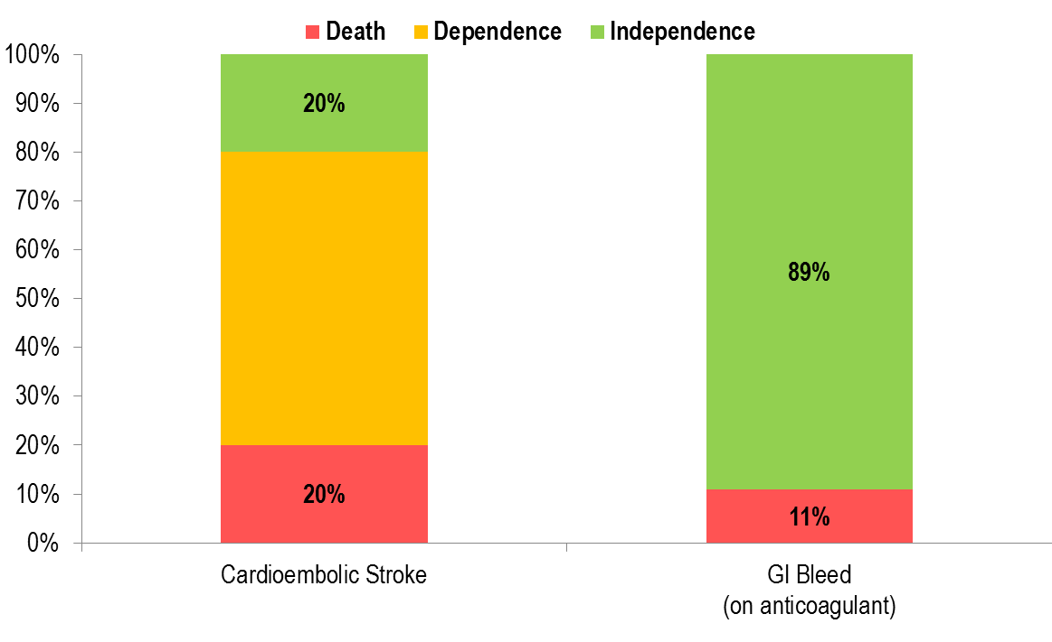
Impact of Cardioembolic Stroke Versus GI Bleeding on Anticoagulant Therapy
1;2 3
.Stroke 1997;28:1367-1374
Stroke 2009;40:235-240
Circulation 2013;128:2325
Notes:
Speaker Notes:
Cardioembolic stroke has major consequences = 20% death, 60% dependence, only 20% independence with or without residual neurological deficit and functional limitations. The outcome of major bleeds on anticoagulant drugs is generally better. For example, for major GI bleedings on anticoag drugs, there are 11% death and 89% survival, and the vast majority of survivors remain independent. There may be some functional limitations among survivors (e.g., partial colectomy...), but they are rarer than following stroke. Intracranial hemorrhage (ICH) is rare but devastating. DOAC actually decrease ICH by 30-70% compared with Warfarin. The weight of outcome x frequency of cardioembolic stroke is generally greater than that of major bleeds. Bleeding risk must be very high to loose the benefit of anticoagulation in AF patients.

Slide 18
What is your next step in Miguel’s management?
Select from one or more of the available options
Continue ASA 81 mg od
Start warfarin (target INR 2-3)
Start Apixaban 5 mg po bid
Start Apixaban 2.5 mg po bid
Start Dabigatran 110 mg po bid
Start Edoxaban 60 mg od
Start Edoxaban 30 mg od
Start Rivaroxaban 20 mg po od
Start Rivaroxaban 15 mg po od
Notes:
Speaker Notes:
Responses 3, 5, 7 & 9

Slide 19
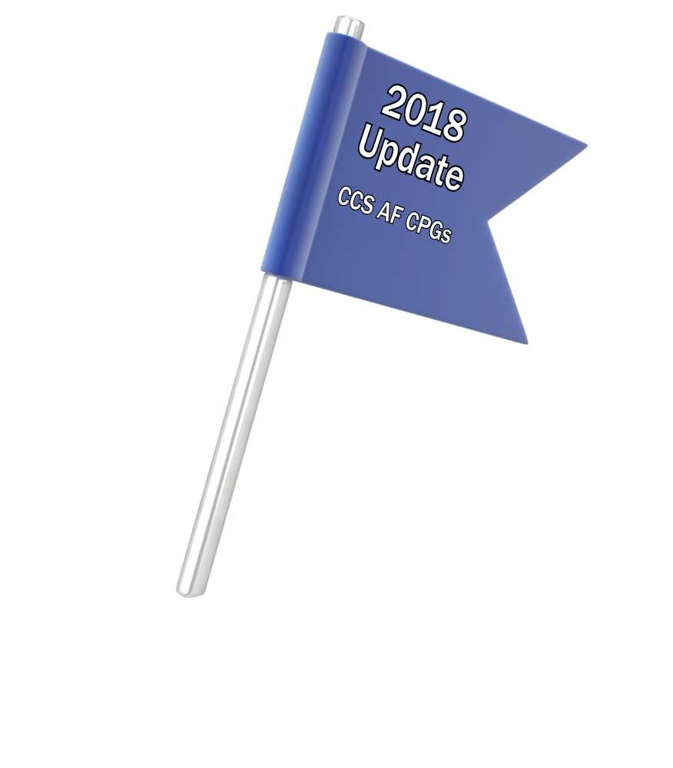
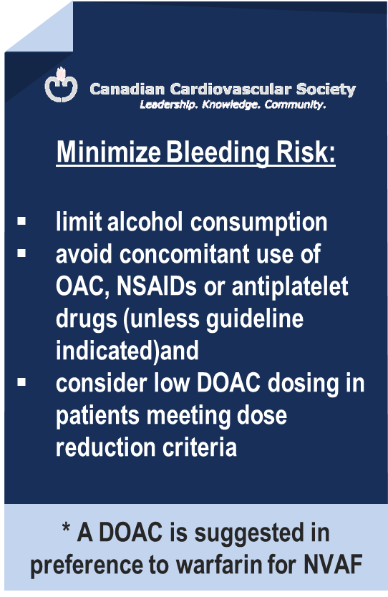
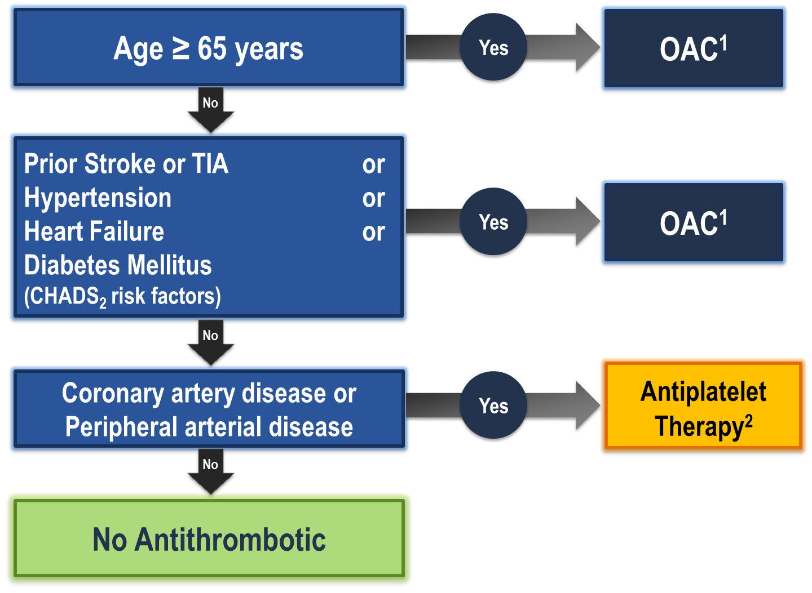
The “CCS Algorithm” (CHADS-65) for OAC Therapy in AF
¹ A DOAC is preferred over warfarin in non-valvular AF
² Therapeutic options include single antiplatelet therapy (ASA 81-100 mg daily) alone; or in combination with either a second antiplatelet agent (e.g. clopidogrel 75 mg daily or ticagrelor 60 mg BID), or an antithrombotic agent (rivaroxaban 2.5 mg BID)
Andrade JG et al. Can J Cardiol 2018;34:1371-1392
CCS AF Guidelines. Can J Cardiol. 2016; 32: 1170-1185
Notes:
Speaker Notes:
This is the new and important slide from the 2018 (box to the right is from the 2016 update) Canadian AF guidelines update.
Two key points to emphasize: the (*) indicates that a DOAC should be selected in preference to an AVK for anticoagulation. The shaded box to the right emphasizes that all efforts should be made to select the correct DOAC dosage based on age, size and renal function as well as to minimize the bleeding risk by addressing any modifiable bleeding risk factors present.
There is no longer any need to calculate a patient’s HASBLED score as this does not influence management (most patients are antioagulated even, if at higher bleeding risk..)
Canada has not adopted the CHADSVASC scoring system to determine eligibility for oral anticoagulation in AF. The annual embolic stroke risk threshold for anticoagulation is set at 1.5% and it is felt that a vascular diseased patient who is aged 64 or less and CHADS2 = 0 has an annual stroke risk of less than 1.5% based on the Canadian Guideline Committee’s interpretation of currently available large data sets.

Slide 20
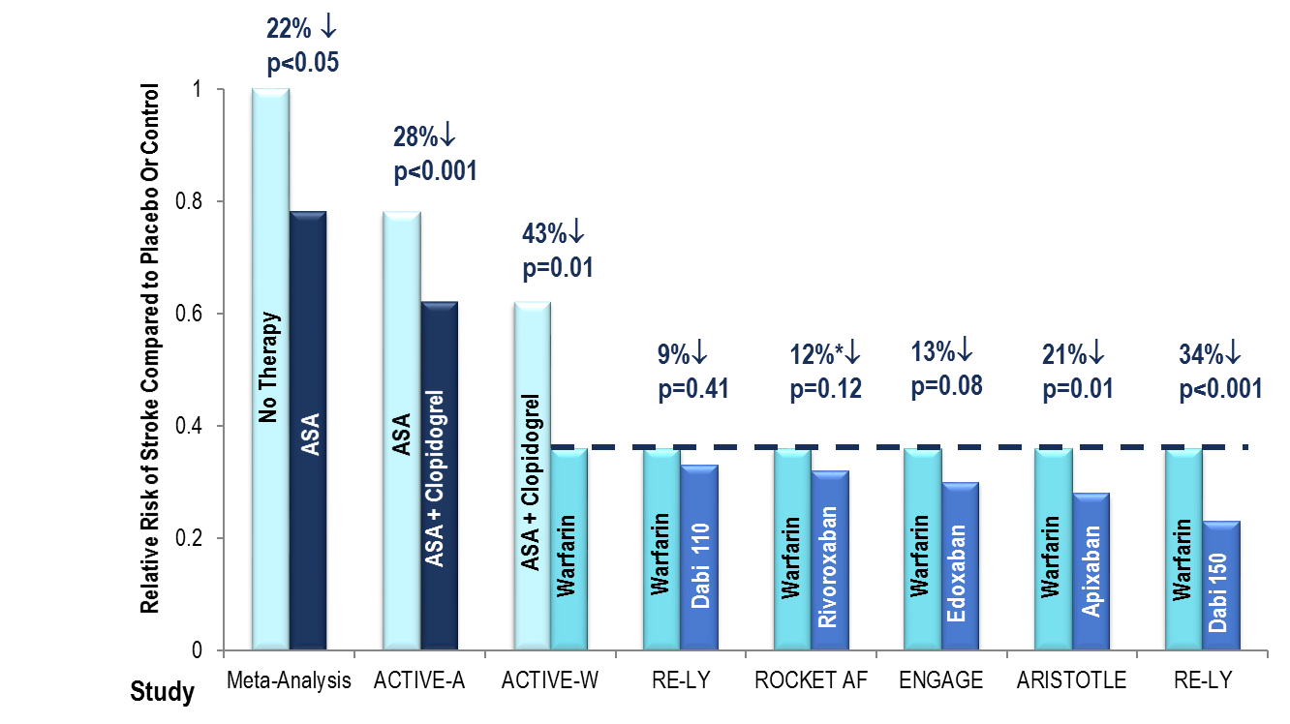
Antithrombotic Therapy in Perspective Stroke + Systemic Embolism (SE) Risk Reduction Efficacy
data for ROCKET AF, RELY, ARISTOTLE and ENGAGE
is for RR Stroke + SE
Lancet 2006;367:1903-1912
N Engl J MedHart RG, Pearce LA, Aguilar MI.
Giugliano RP, et al. NEJM 2013;369:2093-2104
Ann Intern Med 1997;146:857-867. 2009;360:2066-2078
Notes:
Speaker Notes:
Warfarin were: dabigatran 110 bid: 9%; riva: 12%; edoxa: 13% apix 21%; and dabigatran 150 bid: 36% This is slide is intended to be a brief review slide, which summarizes/compares the efficacy of the currently available oral anticoagulants as published in the ACTIVE-A, ACTIVE-W, RE-LY, ROCKET AF and ARISTOTLE Studies. ASA reduces the risk of Stroke, when compared to No Therapy by 22%. The ACTIVE-A Study showed that the combination of ASA plus clopidogrel reduced the risk of Stroke by an additional 28%, when compared to ASA. However, the ACTIVE-W Study showed that the combination of ASA plus clopidogrel is inferior to warfarin, which is known to reduce the risk of Stroke by 64%, when compared to No Therapy. The RE-LY, ROCKET AF and ARISTOTLE Studies compared active treatment to the gold standard, warfarin. In order of increasing efficacy was dabigatran 110mg po bid (8% RRR compared to warfarin, not statistically significant), rivaroxaban 20mg po od (12% RRR compared to warfarin, p=NS), apixaban 5mg po bid (21% RRR compared to warfarin, p<0.01) and dabigatran 150mg po bid (36% RRR compared to warfarin, p<0.001). Of note is that these four studies were compared to warfarin, which is known to reduce the risk of Stroke compared to No Therapy by 64%, so the incremental benefit of the NOACs, in absolute terms are fairly modest.

Slide 21
DOACs as Compared to Warfarin Indirect Comparisons from the Clinical Trials
 | Apixaban¹ ^{(eliquis)} | Dabigatran 110² ^{(Pradaxa)} | Dabigatran 150² ^{(Pradaxa)} | EDOXABAN 60 ^{(lixiana)} | Rivaroxaban³ ^{(Xarelto)}
Stroke/SE
Major Bleed
Intracranial Bleed
GI Bleed
All Cause Death
To date there are no head-to-head trials between apixaban, dabigatran, edoxaban and rivaroxaban, therefore comparative efficacy and safety have not been established
Significant Increase
Significant Reduction
Non Significant Difference
Granger et al., NEJM 2011; 365: 981-992
Connolly et al., NEJM 2009; 361: 1139-1151
Patel et al., NEJM 2011; 365: 883-891
Giuliano RP et al NEJM 2013; 369:2091
Notes:
Speaker Notes:
This slide shows some key efficacy and safety outcome data vs. warfarin from the four major DOAC trials: RE-LY, ROCKET, ARISTOTLE and ENGAGE
Apixaban and Dabigatran 150 mg were associated with significant reduction of stroke/SE vs. warfarin.
Apixaban, Dabigatran 110 mg and Edoxaban were associated with significant reduction of major bleeding vs. warfarin.
All DOACs were associated with a significant reduction of intracranial bleeding (ICH) compared to warfarin.
Dabigatran 150 mg, Edoxaban and Rivaroxaban were associated with an increase in GI bleeding vs. warfarin.
Apixaban is associated with a significant reduction in mortality compared to warfarin.
Definition of major bleeding:
RE-LY: a reduction in the hemoglobin level of at least 20 g per liter, transfusion of at least 2 units of blood, or symptomatic bleeding in a critical area or organ.
ROCKET: as clinically overt bleeding associated with any of the following: fatal outcome, involving a critical site (i.e., intracranial, intraspinal, intraocular, pericardial, intraarticular, intramuscular with compartment syndrome, or retroperitoneal), or clinically overt bleeding associated with a fall in hemoglobin concentration of ≥ 2 g/dL, or leading to transfusion of ≥ 2 units of packed red blood cells or whole blood.
ARISTOTLE: clinically overt bleeding accompanied by a decrease in the hemoglobin level of at least 2 g per deciliter or transfusion of at least 2 units of packed red cells, occurring at a critical site, or resulting in death.
ENGAGE: International Society of Thrombosis and Hemostasis definition : clinically overt bleeding accompanied by a decrease in the hemoglobin level of at least 2 g per deciliter or transfusion of at least 2 units of packed red cells, occurring at a critical site, or resulting in death.
References:
﻿Connolly SJ, et al; for the RE-LY Steering Committee and Investigators. Dabigatran versus warfarin in patients with atrial fibrillation. N Engl J Med 2009; 361:1139-1151.
Connolly SJ, et al; for the RE-LY Investigators. Newly identified events in the RE-LY trial. N Engl J Med 2010; 363(19):1875-1876.
Patel MR, et al; and the ROCKET AF Steering Committee for the ROCKET AF Investigators. Rivaroxaban versus warfarin in nonvalvular atrial fibrillation. N Engl J Med 2011; 365:883-891.
Granger CB, et al; for the ARISTOTLE Committees and Investigators. Apixaban versus warfarin in patients with atrial fibrillation. N Engl J Med 2011; 365:981-992.

Slide 22
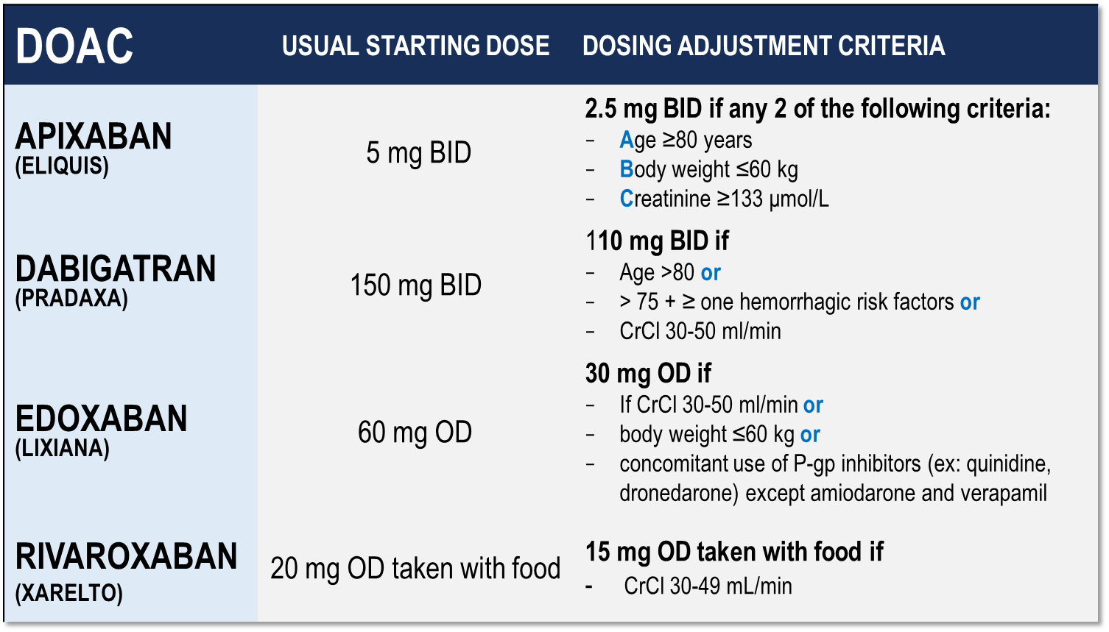
Considerations for Dosing of DOACs
Pfizer Canada Inc./BMS Canada. Eliquis (apixaban) Product Monograph, 2018.
Boehringer Ingelheim Canada Ltd. Pradaxa (dagbatran) Product Monograph. August 11, 2016.
Bayer Inc. Xarelto (rivaroxaban) Product Monograph. 2018.
Daiichi Sankyp Inc. Lixiana (edoxaban) Product Monograph. 2017.
Notes:
Speaker Notes:
Indispensable slide summarizing the criteria for a dosage adjustment from the default higher dosage for the different DOACs currently available in Canada
CrCl is calculated using the Cockgroft Gault formula

Slide 23
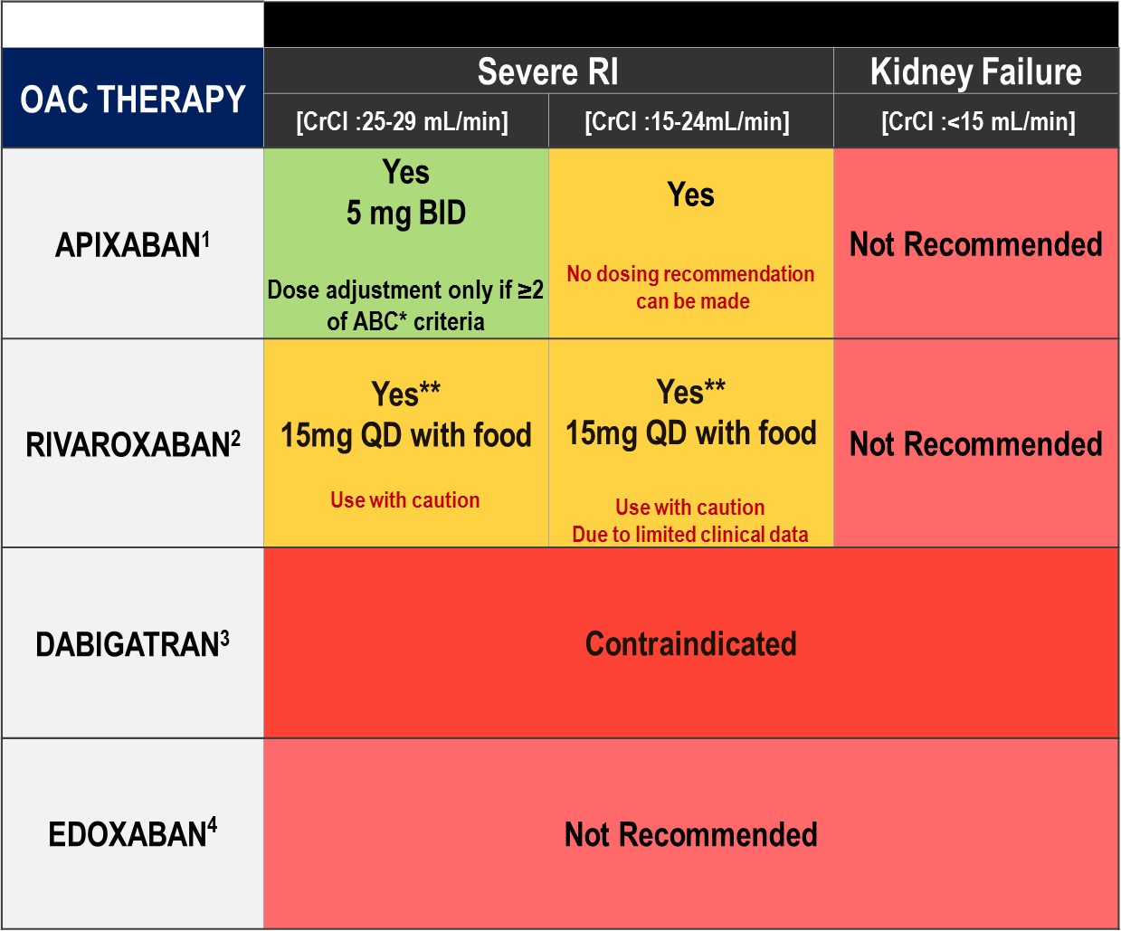
DOACs: Contraindications or Discontinuation Criteria
Pfizer Canada Inc./BMS Canada. Eliquis (apixaban) Product Monograph, 2018.
Boehringer Ingelheim Canada Ltd. Pradaxa (dagbatran) Product Monograph. August 11, 2016.
Bayer Inc. Xarelto (rivaroxaban) Product Monograph. 2018.
Daiichi Sankyp Inc. Lixiana (edoxaban) Product Monograph. 2017.
CrCl calculated from Cockroft-Gault
Notes:
Speaker Notes:
*ABC criteria: Dose reduction to 2.5 mg BID if at least 2 of the following: Age ≥ 80, Body weight ≤ 60kg, serum Creatinine ≥ 133 micromol/L (1.5 mg/dL)
**Moderate renal impairment: Use with caution especially in those concomitantly receiving other drugs which increase rivaroxaban plasma concentrations, consider the benefit/risk of anticoagulant therapy before administering rivaroxaban to patients with moderate renal impairment having a creatinine clearance close to the severe renal impairment category (CrCl < 30 mL/min), or in those with a potential to have deterioration of renal function to severe impairment during therapy.
DOAC, non-vitamin K antagonist oral anticoagulant; AF, atrial fibrillation; CrCL, estimated creatinine clearance

Slide 24
Case 3
You started Miguel on a DOAC
Notes:
Speaker Notes:

Slide 25
What are you going to do about his ASA?
Select from one of the available options
Continue
Stop
Notes:
Speaker Notes:
Correct answer is 2 - Stop

Slide 26
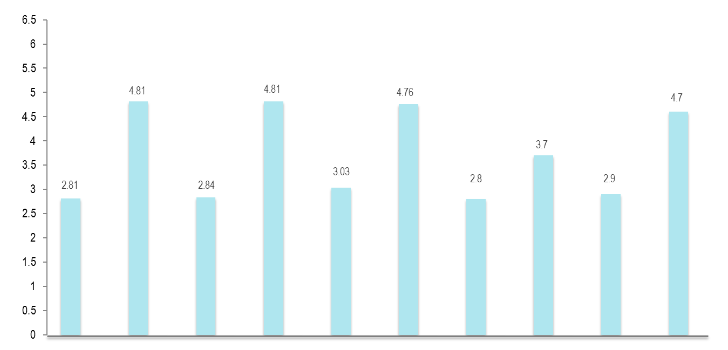
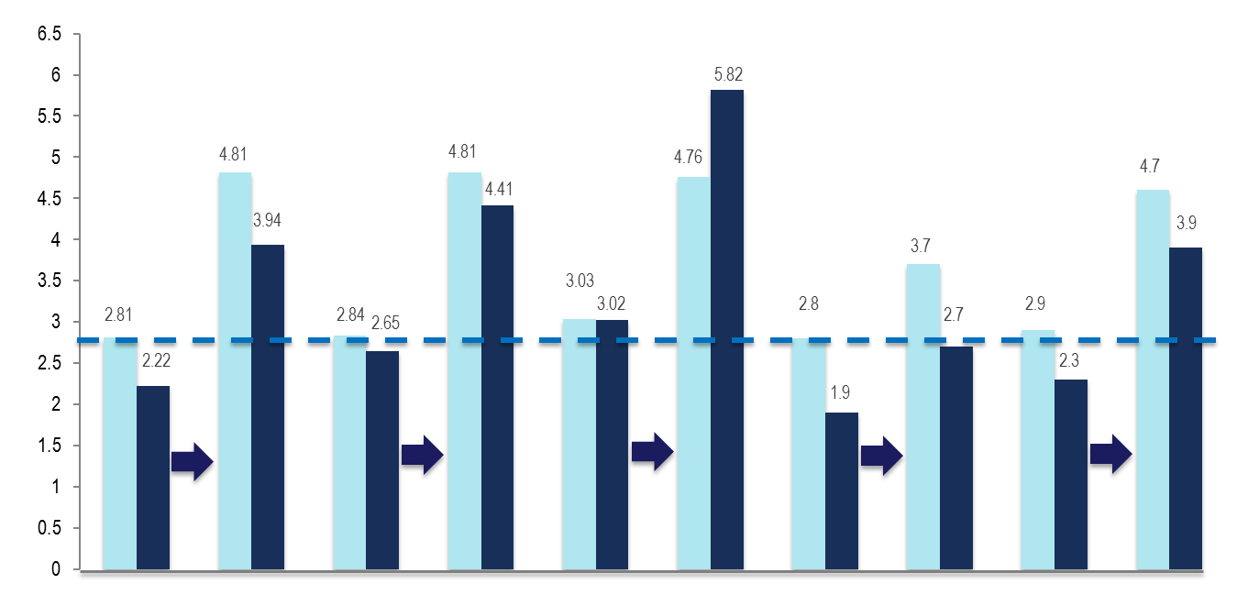
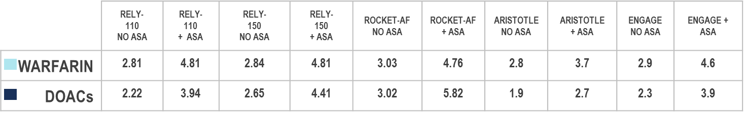
DOAC Indirect Comparisons Risk of Major Bleed / yr (%) w/wo ASA
Addition of ASA increased major bleeding risk by 1.5-2.0 x
Connolly SJ, et al. N Engl J Med. 2009; 361:1139−1151.
Patel MR, et al. N Engl J Med. 2011; 365:883−891.
Granger C, et al. N Eng J Med. 2011; 365:981−992.
Giuliano RP, et al. N Engl J Med. 2013;369:2093-2104.^{[6}
.
P value not available
Notes:
Key Points:
Up to 40% of patients enrolled on the prospective randomized clinical DOAC vs warfarin trials were allowed to concomitantly take ASA if deemed clinically appropriate by the investigator
This slide shows the impact of concomitant DOAC or warfarin PLUS ASA use on the annualized risk of a major bleed. The risk increased substantially in ALL cases whether ASA was added to a DOAC or to warfarin.
The relative safety of being assigned to a DOAC vs warfarin was however maintained for dabigatran 110 mg bid, apixaban and edoxaban

Slide 27
The “CCS Algorithm” (CHADS-65) for OAC Therapy in AF
¹ A DOAC is preferred over warfarin in non-valvular AF
² Therapeutic options include single antiplatelet therapy (ASA 81-100 mg daily) alone; or in combination with either a second antiplatelet agent (e.g. clopidogrel 75 mg daily or ticagrelor 60 mg BID), or an antithrombotic agent (rivaroxaban 2.5 mg BID)
Andrade JG et al. Can J Cardiol 2018;34:1371-1392
CCS AF Guidelines. Can J Cardiol. 2016; 32: 1170-1185
Notes:
Speaker Notes:
This is the new and important slide from the 2018 (box to the right is from the 2016 update) Canadian AF guidelines update.
Two key points to emphasize: the (*) indicates that a DOAC should be selected in preference to an AVK for anticoagulation. The shaded box to the right emphasizes that all efforts should be made to select the correct DOAC dosage based on age, size and renal function as well as to minimize the bleeding risk by addressing any modifiable bleeding risk factors present.
There is no longer any need to calculate a patient’s HASBLED score as this does not influence management (most patients are antioagulated even, if at higher bleeding risk..)
Canada has not adopted the CHADSVASC scoring system to determine eligibility for oral anticoagulation in AF. The annual embolic stroke risk threshold for anticoagulation is set at 1.5% and it is felt that a vascular diseased patient who is aged 64 or less and CHADS2 = 0 has an annual stroke risk of less than 1.5% based on the Canadian Guideline Committee’s interpretation of currently available large data sets.

Slide 28

Key Messages
Risk of recurrent stroke is high and can be estimated with the CHADS₂ score
AF is a common cause of stroke, irrespective of AF type, as well as a common cause of idiopathic or cryptogenic stroke
Subclinical paroxysmal AF (SCAF) can be overlooked if the investigation is not of sufficient duration to rule it out
Anticoagulation therapy with a DOAC is recommended for stroke prevention and preferred over warfarin in the vast majority of AF patients
A previous stroke is a risk factor for future stroke in patients with AF, accounting for 2 points in the CHADS₂ index.
Notes:
Speaker Notes:
AF Is a common cause of stroke (irrespective of AF type)
AF is a common cause of idiopathic stroke, so it is reasonable to repeat investigations (Holters, loop monitors) to continue looking for AF
Anticoagulation for secondary stroke prevention is even more important, as stroke risk is even higher in this population
In patients with AF who have known coronary artery disease (without recent ACS or PCI), NOACs alone are indicated, and ASA should not be used

Slide 29
Backup Slides

Slide 30
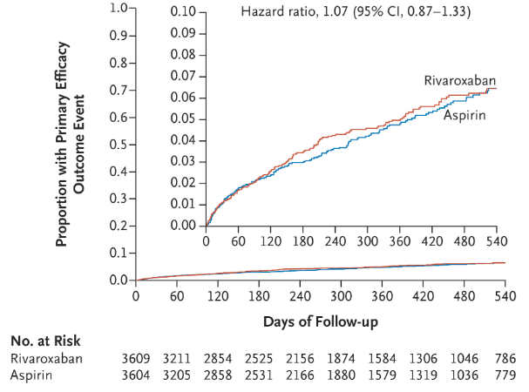
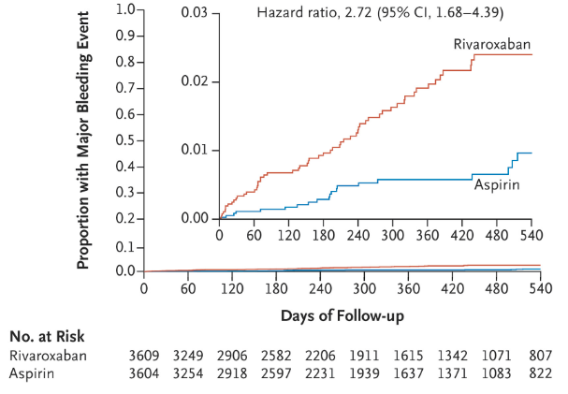
NAVIGATE ESUS Efficacy Outcomes
Kaplan–Meier curves for the time to the first event of the primary efficacy outcome, defined as the recurrence of ischemic or hemorrhagic stroke or systemic embolism
Kaplan–Meier curves for the time to the first primary safety outcome of major bleeding
Insets show the same data on an enlarged y axis.
Hart RG et al. Rivaroxaban for Stroke Prevention after Embolic Stroke of Undetermined Source. N Engl J Med 2018; 378:2191-2201
Notes:
Speaker Notes:
Recurrent strokes in the Navigate-ESUS population may not, in fact, have been embolic or may have been due to heterogeneous embolic sources (e.g. arterial, cardiac or paradoxical via PFO) unresponsive to DOAC therapy.
The primary efficacy outcome of recurrent stroke of any type or systemic embolism occurred in 172 patients in the rivaroxaban group (annualized rate, 5.1%) and in 160 in the aspirin group (annualized rate, 4.8%) (hazard ratio, 1.07; 95% confidence interval [CI], 0.87 to 1.33; P=0.52). This represented 332 (74%) of the anticipated 450 efficacy events that were expected to occur in order for the trial to have adequate power. A total of 314 events (95%) were ischemic strokes, 158 of which occurred in the rivaroxaban group and 156 in the aspirin group (hazard ratio, 1.01; 95% CI, 0.81 to 1.26); 15 events (5%) were hemorrhagic strokes and 3 (1%) were systemic emboli. Of the 314 recurrent ischemic strokes, 36 (11%) were associated with symptoms lasting less than 24 hours but also with neuroimaging evidence of brain infarction, and 5 (2%) could not be classified as ischemic or hemorrhagic because brain imaging was not performed. There were 13 hemorrhagic strokes in the rivaroxaban group, as compared with 2 in the aspirin group. The severity of recurrent ischemic strokes as indicated by the modified Rankin scale score at hospital discharge was similar in the two treatment groups
High Stroke / SE event rate of 5%/year and ischemic stroke rate of 4.7%/year (equal in both groups).
Rivaroxaban 15 mg was unable to reduce this event rate vs. ASA 100mg, suggesting that undiagnosed PAF was not a major cause of recurrent stroke in this population.
In AVEROES, apixaban 5 mg bid (reduced to 2.5 mg bid when 2/3 “ABC” criteria met) was very effective at reducing the rate of stroke / SE. However AVEROES patients had documented AF.

Slide 31
RE-SPECT-ESUS (Embolic Stroke of Undetermined Source)
N=5390
Mean age 64 yrs (60% men)
Median F/U 19 months (event driven)
Rx: dabigatran 150 mg bid (110 mg bid if >75yo or ClCr 30-50 ml/min) vs ASA 100mg daily (75% pts received dabi 150 mg bid)
Primary efficacy outcome = any stroke (ischemic, hemorrhagic, unknown) : 4.1%/yr for dabi and 4.8%/yr for ASA (HR 0.85 NS)
Primary safety outcome = ISTH major bleed : 1.7%/yr for dabi and 1.4%/yr for ASA (HR 1.19 NS)
Results presented at the World Stroke Congress in Montreal – October 2018
Notes:
Speaker Notes:
Embolic Strokes of Undetermined Source (ESUS) are also known as “cryptogenic strokes” and represent about 20% of all ischemic strokes.
RE-SPECT-ESUS (BI) : Dabigatran Etexilate for secondary stroke prevention in patients with embolic stroke of undetermined source. (Preliminary results presented at the World Stroke Congress in Montreal – Oct 2018)
Median time from index stroke to randomization of 45 days
The 5,390-patient ESUS trial—called RE-SPECT ESUS—was designed to test whether dabigatran is superior to aspirin 100 mg a day for the prevention of recurrent stroke. Most patients in the dabigatran arm received 150 mg twice daily, but those 75 years and older and those with moderate renal impairment received the lower 110-mg dose.
Through a mean follow-up of 19 months, the rate of recurrent stroke (primary outcome) was 4.1% per year with dabigatran and 4.8% per year with aspirin, a nonsignificant difference (HR 0.85; P = 0.1). Van Ryn said the Kaplan-Meier curves showed increasing separation between groups, in favor of dabigatran, as follow-up progressed.
The rate of major bleeding was similar in both arms—1.7% per year with dabigatran and 1.4% per year with aspirin, van Ryn said. There were three fatal bleeds—all in the aspirin arm—during the trial.
The trial “provides insight into this concept of ESUS,” van Ryn said. “I don’t think you could say it was a failure for dabigatran. There was this hint of an improvement, and I think now it really provides a lot of excitement for the field to try and understand which patients may benefit from this and potentially refine the concept of ESUS and maybe find better treatments for these patients.”
Another direct oral anticoagulant (DOAC), rivaroxaban (Xarelto; Bayer/Janssen), also failed to demonstrate a benefit in an ESUS population. Asked whether it’s still possible that DOACs could prove useful in this group of patients, Van Ryn said it’s too early tell.

Slide 32
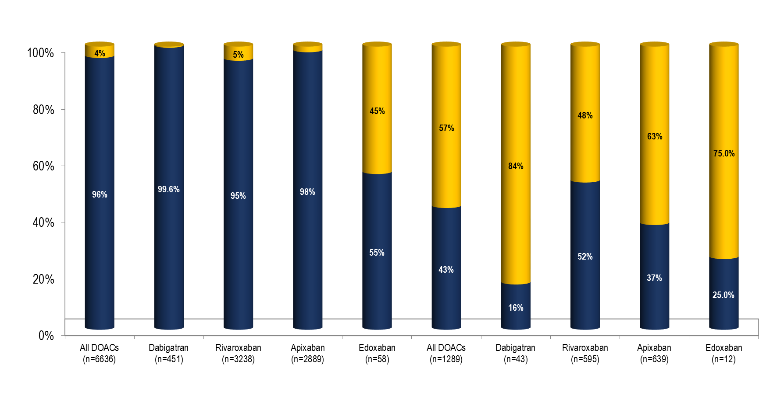
Frequency and Outcomes of Reduced Dose DOACs: Result From ORBIT-AF II
Appropriate
Inappropriate
Standard Dose
Reduced Dose
Underdosing is common: 50% of patients treated with low dose DOACs should be on high dosage
Steinberg BA, et al. J Am Heart Assoc. 2018 Feb 16;7(4)
Notes:
Speaker Notes:
Abstract
BACKGROUND:
Non-vitamin K antagonist oral anticoagulants (NOACs) are indicated for stroke prevention in atrial fibrillation (AF) but require lower doses in certain patients. We sought to describe the frequency, appropriateness (according to Food and Drug Administration labeling), and outcomes of patients prescribed reduced doses of NOACs in community practice.
METHODS AND RESULTS:
We analyzed data from the ORBIT-AF II (The Outcomes Registry for Better Informed Treatment of Atrial Fibrillation II) registry, a prospective, national, observational registry of AF patients. Among 7925 AF patients receiving NOACs, we assessed patterns of use of reduced NOAC doses and associated cardiovascular and bleeding outcomes at median follow-up of 1 year. Overall, 6636 patients (84%) received a NOAC at standard dose, which was consistent with US Food and Drug Administration labeling in 6376 (96%). Reduced NOAC dose was prescribed to 1289 (16% overall), which was consistent with Food and Drug Administration labeling in only 555 patients (43%). Compared with those whose NOAC dose was appropriately reduced, patients receiving inappropriate dose reductions were younger (median age 79 versus 84, P<0.0001) and had lower ORBIT bleeding risk scores (26% ≥4 versus 45%, P<0.0001). Compared with those appropriately receiving standard dosing, patients receiving inappropriately reduced-dose NOACs had higher unadjusted rates of thromboembolic events (2.11 versus 1.35 events per 100 patient years, hazard ratio 1.56, 95% confidence interval 0.92-2.67) and death (6.77 versus 2.60, hazard ratio 2.61, 95% confidence interval 1.86-3.67). After adjustment, outcomes were not significantly different but tended to favor patients dosed appropriately.
CONCLUSIONS:
The majority of dose reductions of NOACs in AF are inconsistent with US Food and Drug Administration recommendations. There appear to be opportunities to improve current NOAC dosing in community practice.

Slide 33
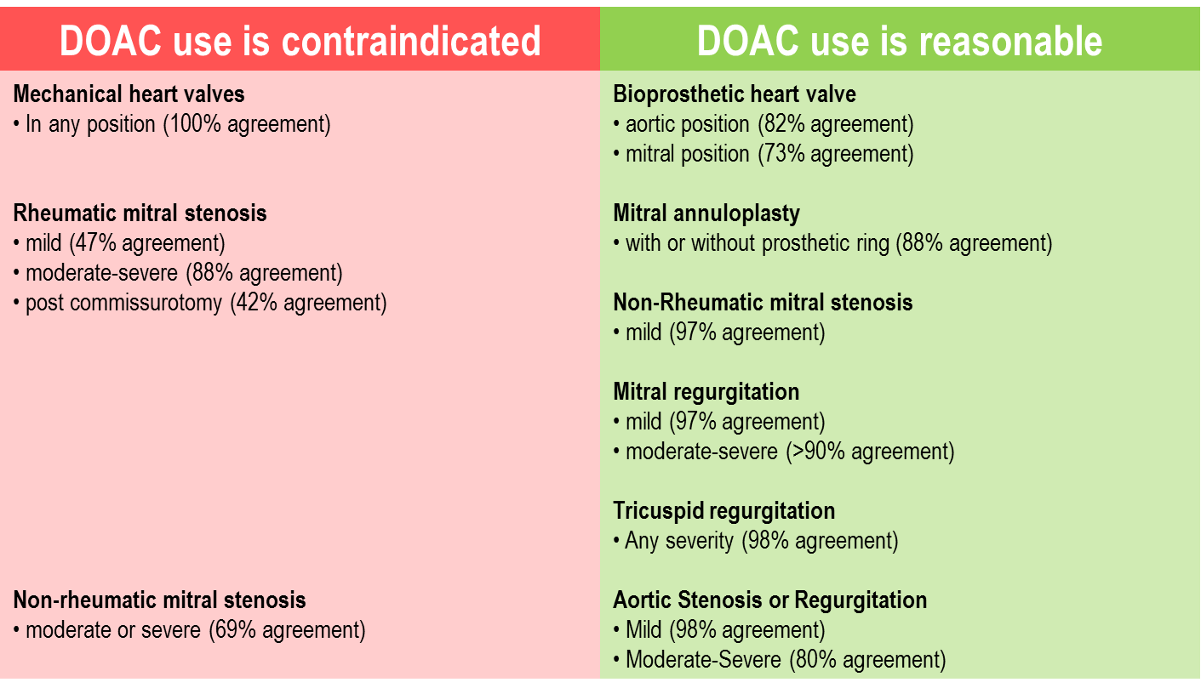
Expert Opinion Survey Regarding the Clinical Use of a DOAC in Relation to Commonly Encountered Scenarios
Would you consider DOAC use to be 1) contraindicated or 2) not contraindicated (i.e. reasonable to use) with the following valvular disorders?
Adapted from:
Macle, L., Verma, A., et al, The 2014 Atrial Fibrillation Guidelines Companion:
A Practical Approach to the Use of the Canadian Cardiovascular Society
Guidelines. Canadian Journal of Cardiology. 2015;31:1207-1218.
Notes:
Speaker Notes:

Slide 34
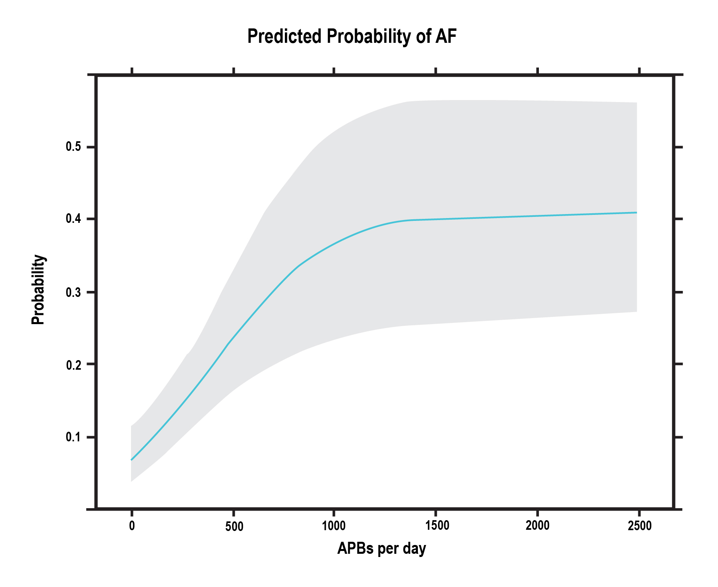
Probability of Detection of Paroxysmal AF based on the Number of Atrial Premature Beats (APB)
Gladstone et al. Stroke. 2015;46:936-941
Notes:
Speaker Notes:
Predicted probability of paroxysmal atrial fibrillation according to number of atrial premature beats/24 h on a Holter monitor study. AF indicates atrial fibrillation; APB.

Slide 35
HASBLED: Major Bleeding Risk in AF Patients Treated with VKA
Risk Factor | Score
Hypertension (TAS ≥160 mmHg) | 1
Abnormal renal or liver function | 1 or 2
Stroke | 1
Bleeding predisposition or history | 1
Labile INR | 1
Elderly (>65 years) | 1
Drugs or alcohol | 1 or 2
Maximum Score | 9
Pisters R, et al. Chest 2010;138:1093-1100
Notes:
Speaker Notes:
HASBLED does not predict bleedings in AFib patients on DOACs. It tells which bleeding risk factors can be controlled to reduce the risk

